Slide 1
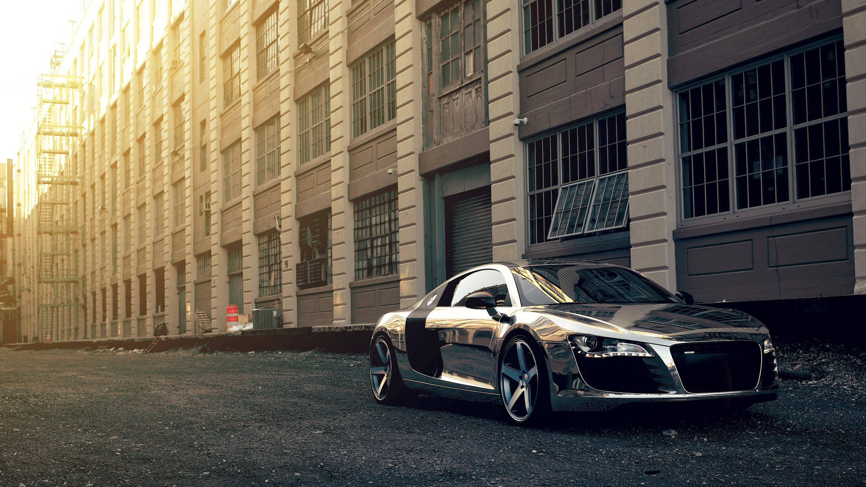




CAR ZONE
ONLINE
CAR SHOP
A WEBSITE MADE USING HTML

Slide 2



ABOUT OUR CODE
Welcome to [CAR ZONE], your premier destination for a seamless and exhilarating online car shopping experience. At [CAR ZONE], we redefine the way you explore, choose, and acquire your dream car, all from the comfort of your own home. Our digital showroom is meticulously curated to showcase a diverse and premium selection of vehicles that cater to a wide range of preferences and lifestyles.

Slide 3
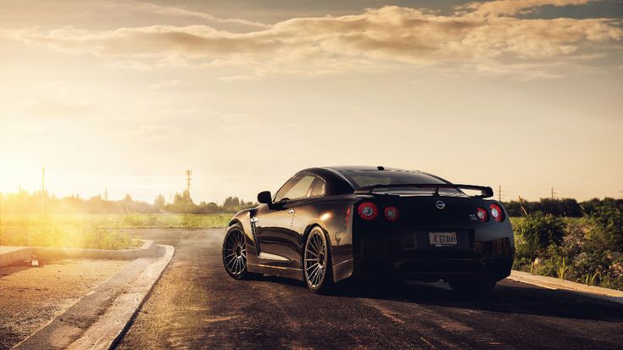



OUR WEBSITE
Home page
car’s shop
contact us
a page with a simple interface leading you to the shop and how you contact the developers
a page where cars are reviewed with detailed description and multiple options
a contact page to keep in touch with website developers if there any questions or troubles

Slide 4


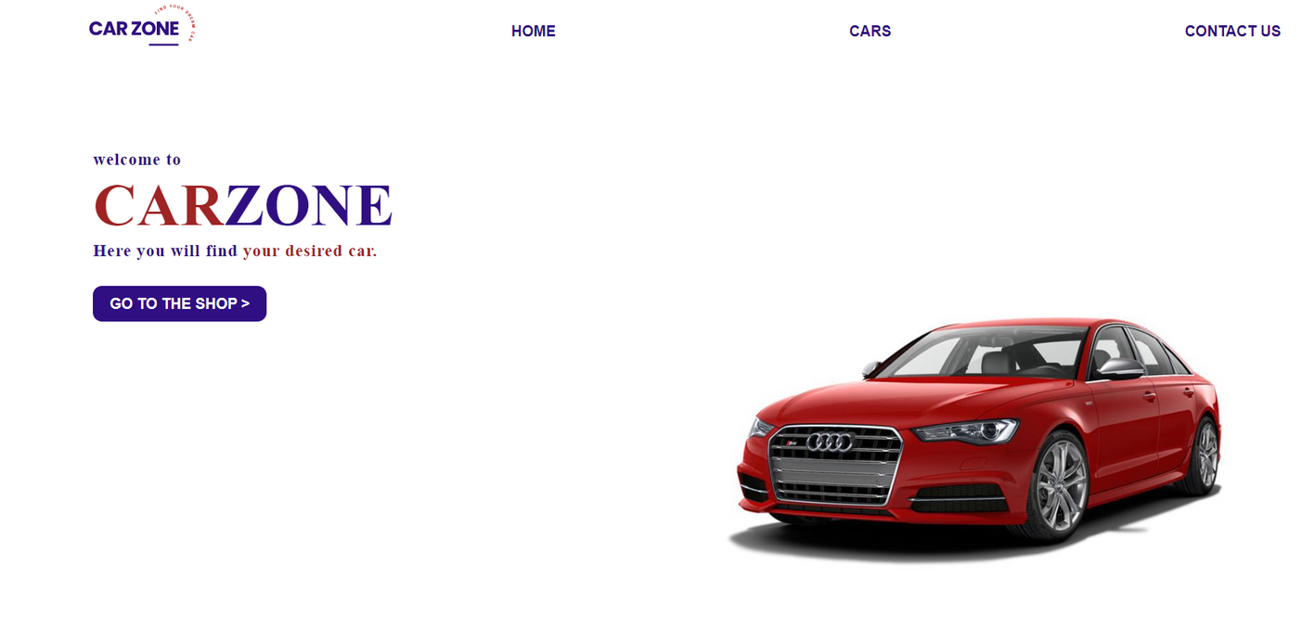
HOME PAGE
<!DOCTYPE html>
<html lang="en">
<head>
<title>CarZone | HOME</title>
</head>
<body>
<div class="navbar">
<img src="images/logo.png" class="logo" alt="logo">
<a href="home.html">HOME</a>
<a href="cars.html">CARS</a>
<a href="contact us.html">CONTACT US</a>
</div>
<div class="info">
<h3>welcome to</h3>
<h1><span>CAR</span>ZONE</h1>
<h3>Here you will find <span>your desired car.</span></h3>
<a href="cars.html">GO TO THE SHOP ></a>
</div>
</body>
</html>

Slide 5

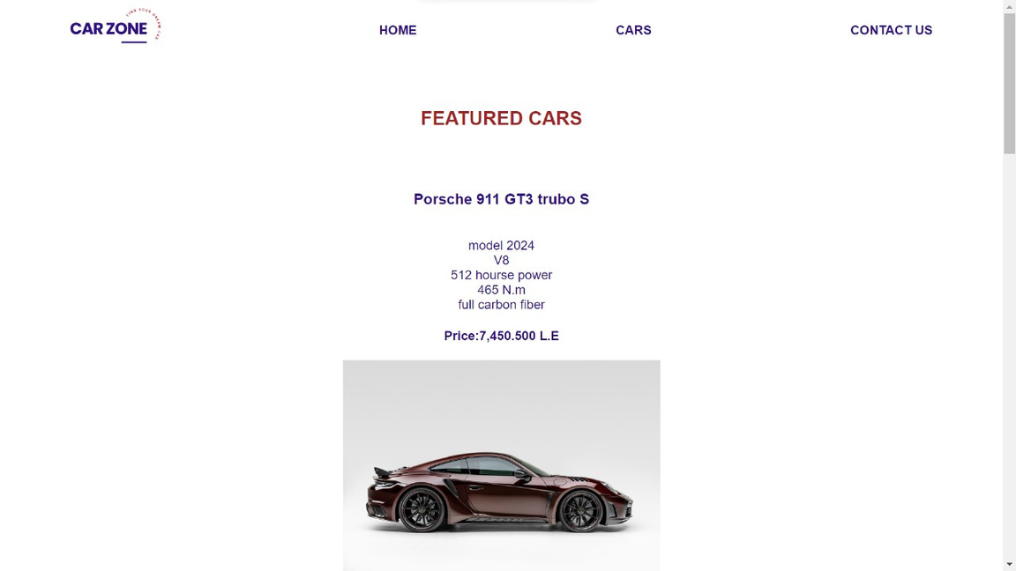
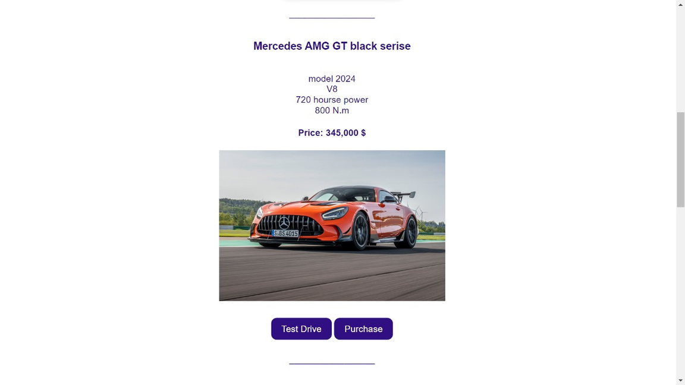
example to add a car
adding a car :
<h3>car name</h3>
<br> car model
<br> car discribtion
<br> car discribtion
<br> car discribtion
<h4> car price </h4>
<img src="car image.jpg " alt="Car Model"
width="400">
<br>
<a href="#">Test Drive</a>
<a href="#">Purchase</a>
<br>
_________________
<br>
<br>
</div>

Slide 6
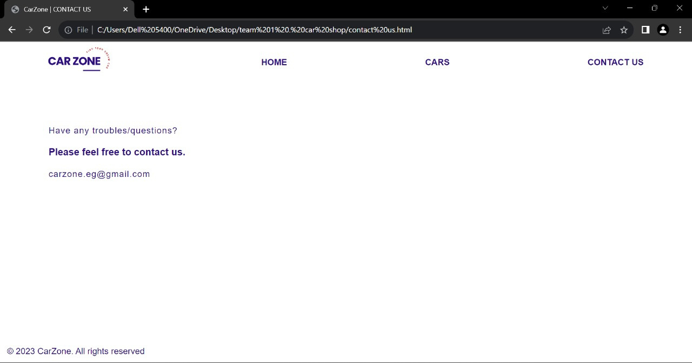

<!DOCTYPE html>
<html lang="en">
<head>
<title>CarZone | CONTACT US</title>
</head>
<body>
<div class="navbar">
<img src="images/logo.png" class="logo" alt="logo">
<a href="home.html">HOME</a>
<a href="cars.html">CARS</a>
<a href="contact us.html">CONTACT US</a>
</div>
<div class="contact-us">
<h4>Have any troubles/questions?</h4>
<br>
<h3>Please feel free to contact us.</h3>
<br>
<h4>carzone.eg@gmail.com</h4>
</div>
<section class="bottom-text">
<br>
<br>
<p>© 2023 CarZone. All rights reserved</p>
</section>
</body>
</html>
Contact Us

Slide 7
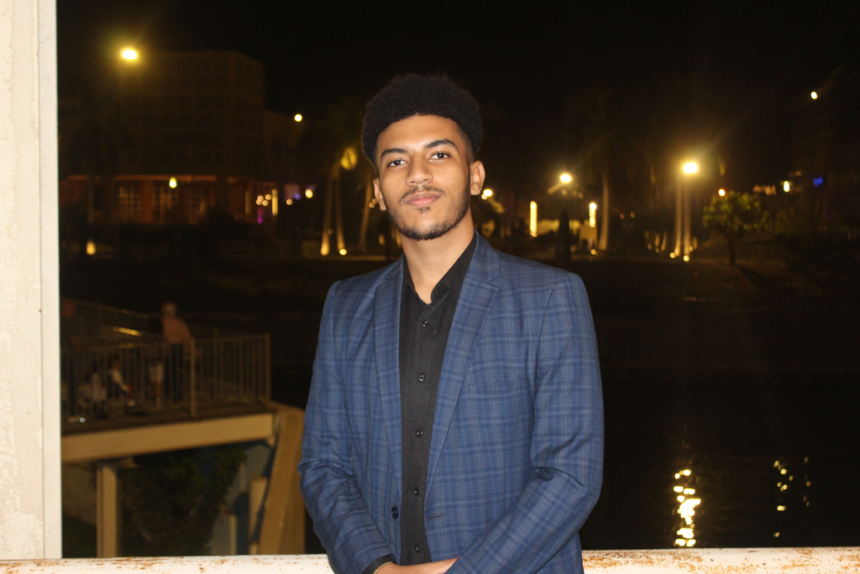


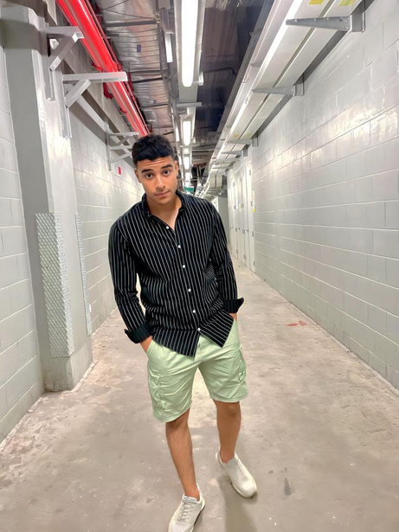

OUR TEAM
Amira Nasser
Mark
john
Ammar shousha
Yousef elsayed
Donia
Tarek
200038804
200036305
200036304
200036307
200047914

Slide 8








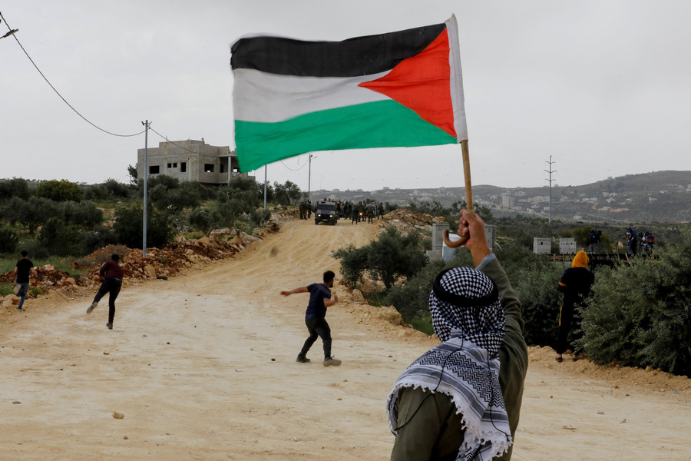

CAR ZONE
STAND
THANK YOU !
PALESTINE
WITH
WE

